Slide 1
Plugged In or Left Behind?
An analysis of Germany's infrastructure readiness for the transition to electric vehicles
Adeline Silva Schäfer, April 2025
Notes:
Hello Everyone, my name is Adeline and I am going to talk about Germany‘s readiness for the shift towards electric vehicles

Slide 2
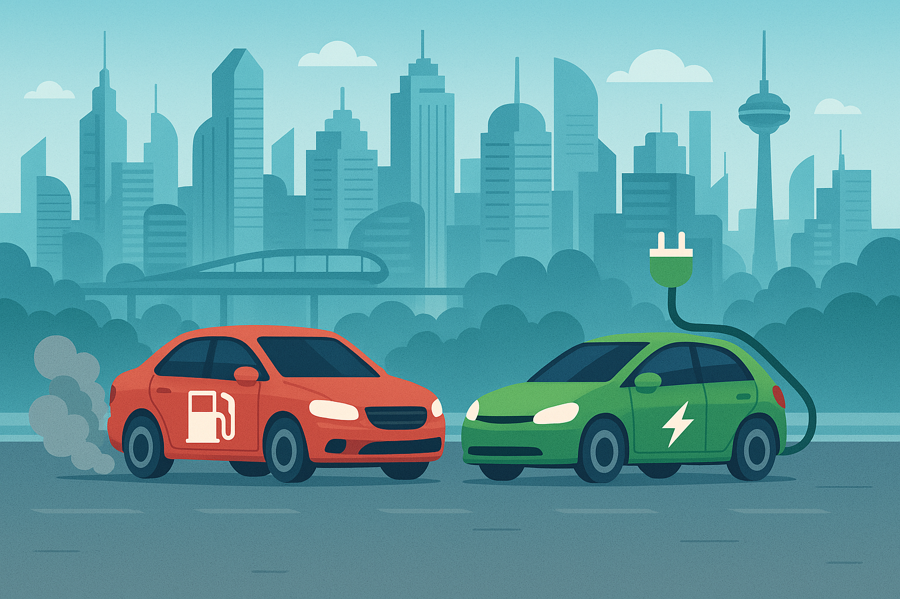
Research question: Is Germany prepared for the shift towards electric vehicles?
Notes:
To give a bit of context, in order to reduce CO₂ emissions, the European Union has agreed on banning the sale of new petrol and diesel cars starting in 2035. This transition will increase the demand for electric vehicles (EVs) and, consequently, for charging infrastructure.
Is Germany prepared for this shift?
Why Germany? Because it is Europe’s largest economy and home to its most powerful automotive industry.

Slide 3





Datasets
Germany’s vehicle fleet, from the Federal Ministry for Digital and Transport (2018-2025)
Charging stations, from Bundesnetzagentur, the primary regulatory body for infrastructure in Germany. (2018-2025)
Germany’s population, from Federal and State Statistical Offices (2022)
Gas stations, from: Federal Association of Independent Petrol Stations (2018-2024)
Notes:
To perform my analysis, I got information about German‘s vehicle fleet, from the Federal Ministry for Digital and Transport from January 2019 to January 2025
Then the number and type of charging stations, from Bundesnetzagentur, the primary regulatory body for infrastructure in Germany. (2018-2025)
Germany’s population, from Federal and State Statistical Offices (2022)
Gas stations, from: Federal Association of Independent Petrol Stations (2018-2024)

Slide 4
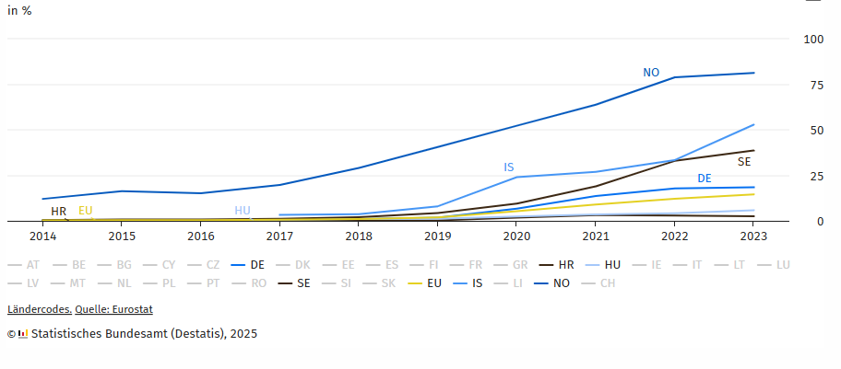


Electric vehicles adoption in Europe
Share of electric vehicles among new registrations
Notes:
Before we start with the information from the datasets, let’s understand the context.
In Europe, Germany has the largest fleet of electric vehicles. However, countries like Norway and Iceland are significantly ahead in terms of adoption. In Norway, 90% of new cars are electric, compared to just 18% in Germany.

Slide 5


Climate Protection Act (2019) – Goals until 2030
Reduced emissions
65% reduction in CO₂ emissions
Larger EV fleet
15 million electric vehicles
Better infrastructure
1 million charging points
Notes:
To achieve the EU targets, Germany passed a climate protection law in 2019 that sets out some ambitious goals:
CO2 emissions are to be reduced by 65%.
To achieve this, 1 million charging stations
15 million electric vehicles

Slide 6
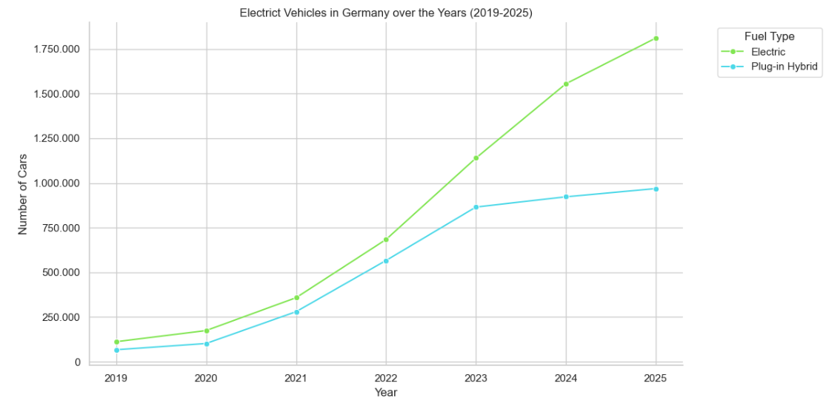
Growth of Germany’s EV Landscape
Notes:
Let’s examine the growth of electric vehicles over the past six years.
We see a steady increase in EVs.

Slide 7
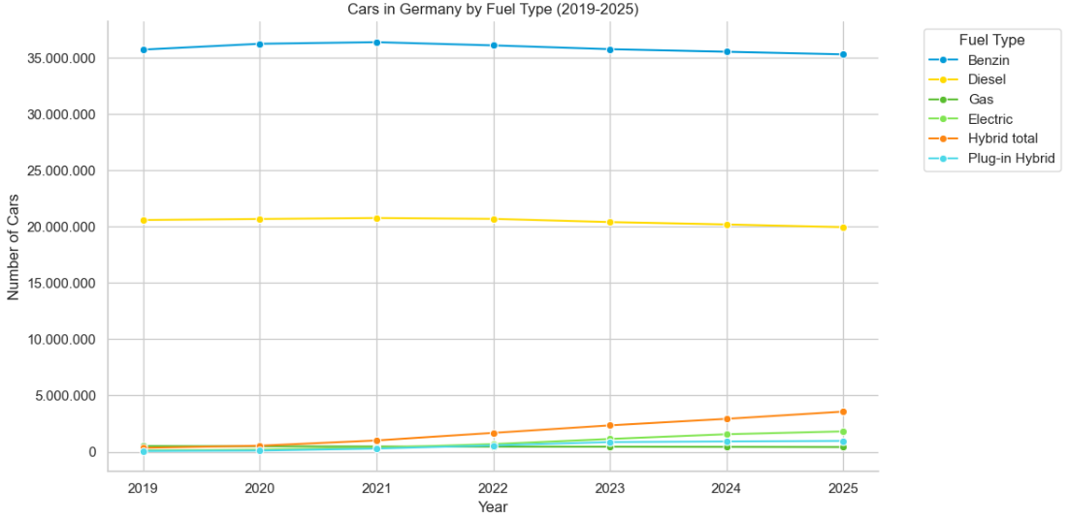
Notes:
However, when compared to other vehicle types, the gap remains substantial.

Slide 8
Growth of Germany’s EV Landscape
Notes:
From 2023 onward, we observe a slowdown in EV adoption. This is most likely due to the end of incentives for purchasing electric vehicles.

Slide 9
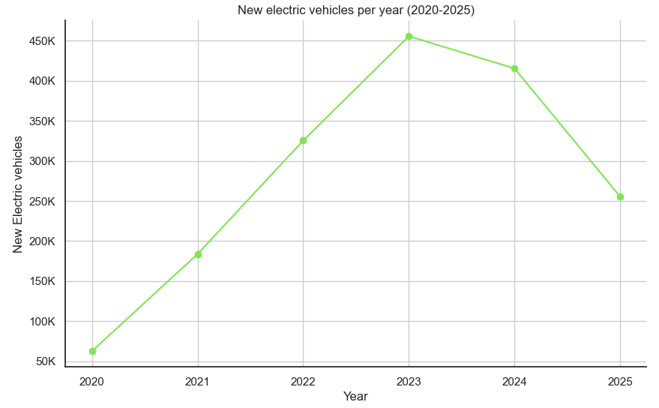
Why is the number of new electric vehicles going down?
End of incentives for electric vehicles

Slide 10
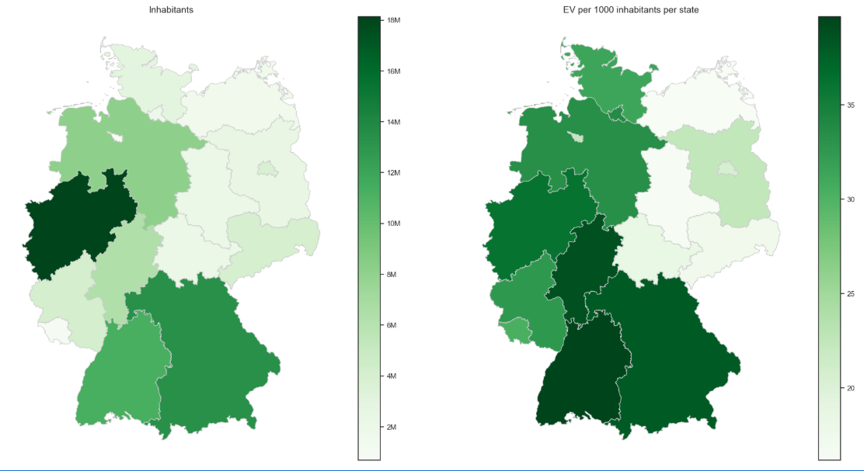
How are the EVs distributed in Germany
Notes:
The number of electric vehicles in Germany correlates with the population size of the federal states. We can also see that electric vehicles are primarily found in the western federal states.

Slide 11
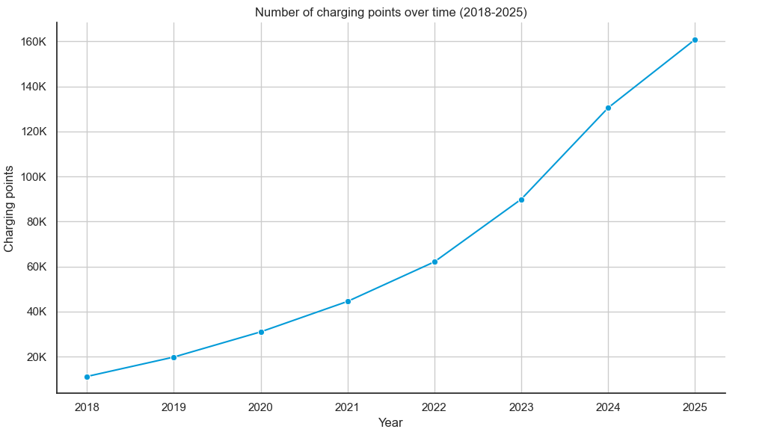
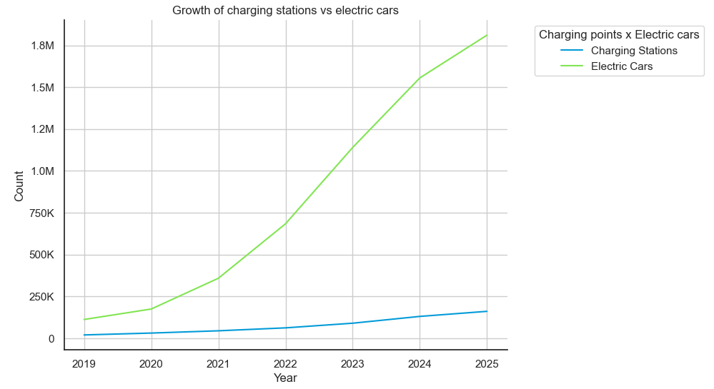
What about the charging infrastructure?
Notes:
Well, we see that the infrastructure is growing as well. There is a strong correlation (0,98) to the number of cars. However the infrastructure grows in a much slower on a slower pace.

Slide 12
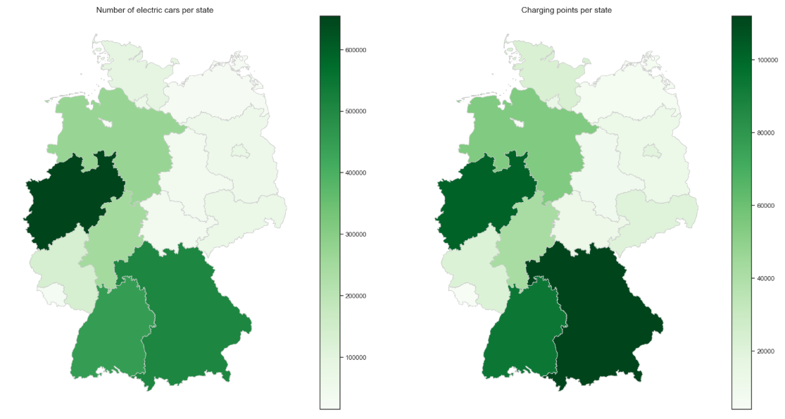
Electric vehicles and charging points
Notes:
The number of charging points correlates with the number of cars. Not surprisingly, the number of cars and charging stations is bigger in the richest states (North-Rhein-Westphalia, Bavaria and Baden Württenberg)

Slide 13

Is it enough?
11
Electric vehicles per
charging point
636
ICE vehicles per fuel pump
= 1.000.000
Notes:
But what does it mean? Well, when comparing the charging infrastructure, to the gas stations infrastructure, we see that it is actually bigger than the infrastructure for ICE-Vehicles. However, this is not a proper comparison, since there are many different factors that influence this comparison, like vehicle autonomy and also the speed of the charging.

Slide 14
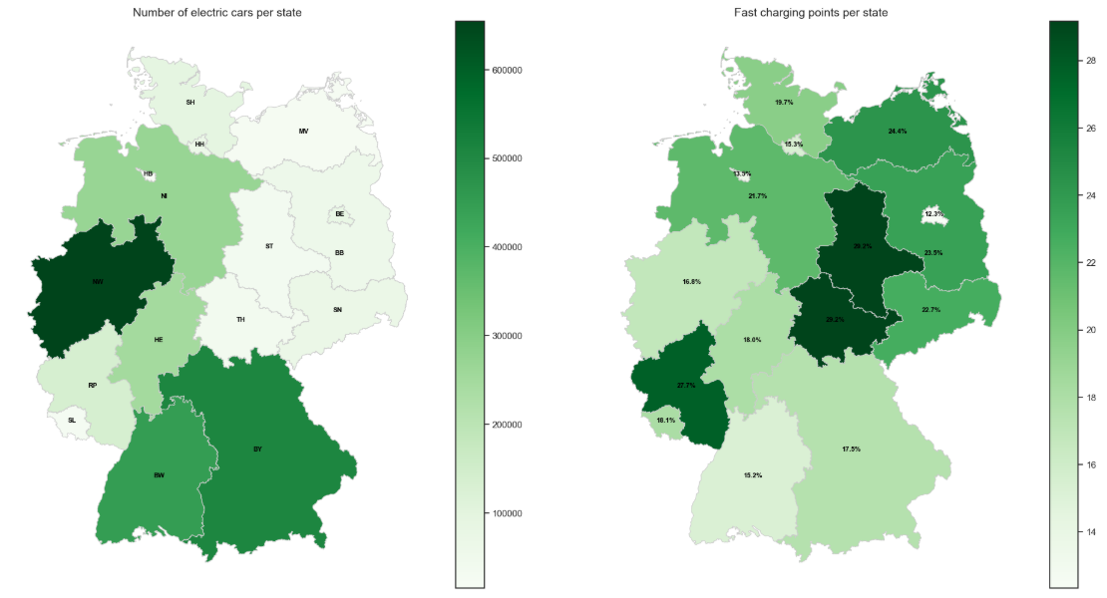
Fast charging points
Notes:
Some states are better prepared than others. But overall, the percentage of fast charging points is smaller than 30 %

Slide 15
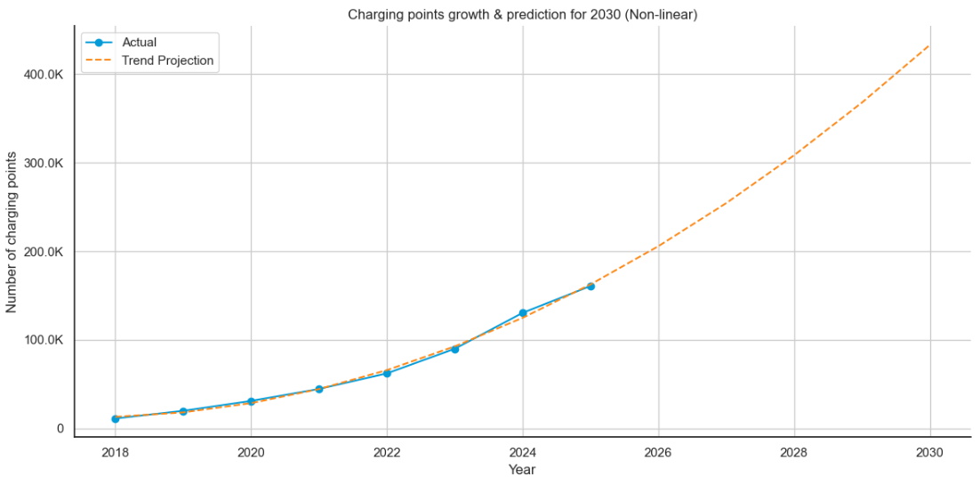
1 million charging points by 2030?
Notes:
Coming back to the goals for 2030. Is it realistic to achieve 1 Million charging points by 2030?
The numbers show that we are not achieving this goal. We would need about 170K charging points per year. Which is about the number of charging points that we have today.

Slide 16
Is it so bad?
EV Owners
Potential
EV-Buyers
44%
25%
of electric vehicle owners have a solar power system.
Currently own a solar power system
24%
34%
of electric vehicle owners plan to make a purchase within the next 3 years.
Intend to invest in solar power systems
Source: ADAC, 2023
Notes:
Is it really bad?
Well, one aspect to be considered in this equation is, that a significant amount of electric vehicle owners have a solar power system and can charge their cars at home. According to a survey by ADAC, 44% of the of EV-Owners have a solar power system and 254% plan to purchase one within the next 3 years

Slide 17
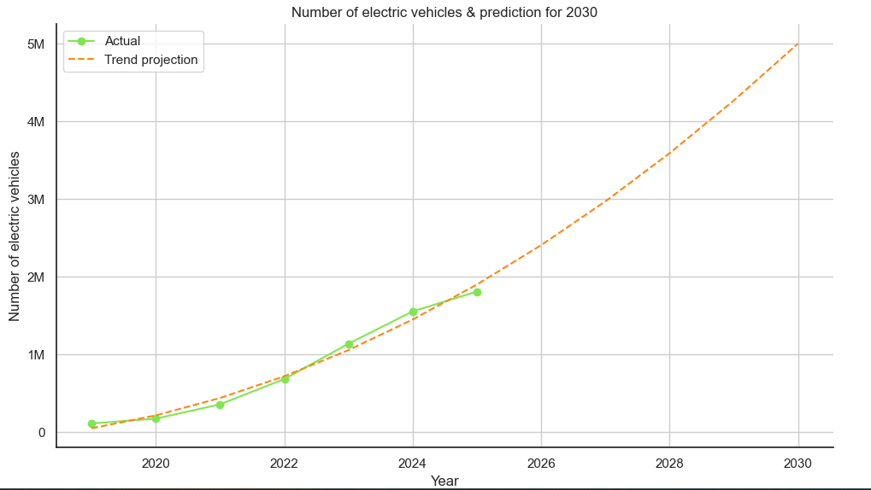
What about the electric vehicles?
Notes:
Well, the number of electric vehicles is also not going to achieve the goals for 2030,

Slide 18
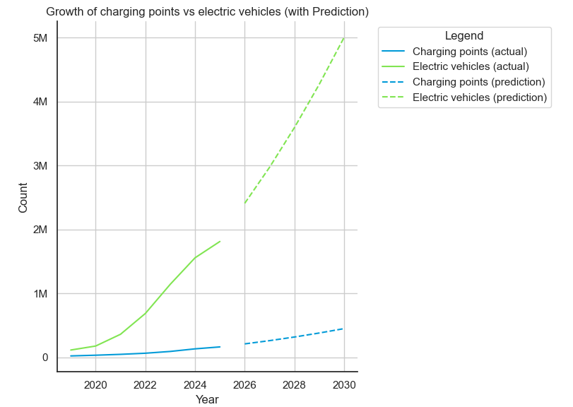
Is it getting better or worse?
Notes:
Well according to this projection, the infrastructure will be worse than the one we have now

Slide 19

Conclusions
The infrastructure must accelerate its development, as it is progressing at a much slower rate than the increase in vehicles
Germany is quite unlikely to achieve its targets for 2030
Providing incentives for electric vehicles could potentially enhance the current situation

Slide 20
Thank you
Adeline Silva Schäfer, April 2025

Slide 21
Data Sources
Car registrations in Germany:
https://www.kba.de/DE/Statistik/Produktkatalog/produkte/Fahrzeuge/fz27_b_uebersicht.html?nn=4543062
Charging stations in Germany:
https://www.bundesnetzagentur.de/DE/Fachthemen/ElektrizitaetundGas/E-Mobilitaet/Ladesaeulenkarte/start.html
Gas Stations:
https://www.bft.de/daten-und-fakten/entwicklung-tankstellenanzahl
Population:
https://www.statistikportal.de/de/bevoelkerung/flaeche-und-bevoelkerung

Slide 22
References
Climate Protection Act
https://www.gesetze-im-internet.de/englisch_ksg/index.html

